Slide 1
Big Mountain Resort
OpEx Cost Recovery Plan – July 2020

Slide 2
Contents
Problem Statement
Recommendation
Model
Dataset
Exploratory Analysis
Modelling
Prediction
Summary

Slide 3
Problem Statement
How can Big Mountain Resort increase revenue to cover cost of new chair lift and maintain 9.2% profit margin in this financial year?
Context
The resort has recently installed a new chair lift to increase the distribution of visitors across the mountain, adding an additional $1.54m to OPEX this year. The business has a profit margin of 9.2% and wants to maintain this going forward.
Criteria for success
Identify a way to increase revenue to level that allows company to maintain 9.2% business profit margin for the upcoming season
Project Scope
Understand if there is an opportunity for the resort to increase ticket prices by developing a model to predict optimal ticket price, and therefore drive additional revenue
Constraints
Data availability
Ability to increase ticket price may not be viable for other commercial or operation reasons

Slide 4
Recommendation
Use available data to model and predict Big Mountain price for upcoming year
Steps:
Access and understand data
Gain access to required data
Explore data to understand trends and issues in data
Adjust dataset to put in shape for analysis / modelling
Model data
Model data with response variable of ticket price to better predict optimal pricing for Big Mountain Resort
Iterate through models to identify best fit for data
Predict price
Use best model to predict optimal price point for Big Mountain Resort going forward

Slide 5
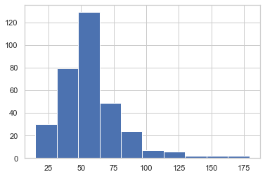
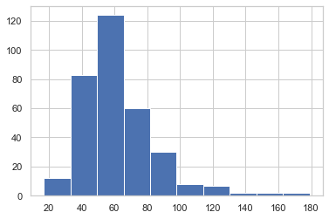
Model – Dataset
Variable Name | Mean
Name | n/a
Region | n/a
State | n/a
summit_elev | 4591.82
vertical_drop | 1215.43
base_elev | 3374.00
trams | 0.17
fastEight | 0.01
fastSixes | 0.18
fastQuads | 1.09
quad | 0.93
triple | 1.50
double | 1.83
surface | 2.62
total_chairs | 8.27
Runs | 48.21
TerrainParks | 2.82
LongestRun_mi | 1.43
SkiableTerrain_ac | 739.80
Snow Making_ac | 174.87
daysOpenLastYear | 115.10
yearsOpen | 63.66
averageSnowfall | 185.31
AdultWeekday | 57.92
AdultWeekend | 64.17
projectedDaysOpen | 120.05
NightSkiing_ac | 100.40
Data
Acquired dataset with data on 330 resorts across the USA
27 variables (see table with mean value, if applicable)
File updated to handle missing values
File checked to remove duplicates
Response Variable
Focus on AdultWeekday and AdultWeekend as response variable to support problem statement
AdultWeekday
Distribution
AdultWeekend
Distribution

Slide 6
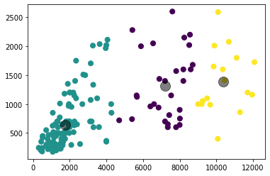
Model – Exploratory Analysis
Anomalies & Outliers
Removed rows with values outside Inter-quarterial range (IQR) reducing data to 176 resorts
Data Relationships
Identify variables with high correlation (>0.95) to remove from data set
This included ‘base_elev’ and ‘sum_chairs’ that were dropped from data set
Clusters
Used k-means clustering technique to identify three clusters in dataset (see beside)

Slide 7
Model – Modelling
Three models performed
All included splitting data into training and test data (75/25)
Linear regression models
Performance of each model in table below
1st Model (including all features)
Strong fit with 0.928 explained variance
States had the top 10 strongest coefficients of all features in this model
Provides little value to support action for Big Mountain Resort so removed from model
2nd Model (without ‘state’)
Strong fit with 0.922 explained variance
Summit elevation and base elevation were in Top 3 strongest coefficients of all features in this model
Provides little value to support action for Big Mountain Resort so removed from model
3rd Model (without states or elevations)
Strong fit with 0.924 explained variance
Provides model similar to previous but with different top 10 coefficients
Model | Explained Variance | Mean Absolute Error | Features Dropped
Model 1. | 0.928 | 5.35 | -
Model 2. | 0.922 | 5.54 | 'state'
Model 3. | 0.924 | 5.53 | 'state','summit_elev','base_elev'

Slide 8
Model – Result
Model 3 Coefficients
3rd Model selected as best model
Maintained high explained variance and similar mean absolute error compared to alternative models
Contains more relevant and actionable features than alternative model (see coefficient model on right)
Big Mountain Resort Prediction
Ran model on Big Mountain Resort data to allow it to predict suggested pricing based on features included in model
Model suggested price of $88.77 for Adult Weekend tickets
This is +$7.77 higher than existing price of $81
Feature | Coefficient
AdultWeekday | 19.893397
averageSnowfall | 1.982708
Runs | 1.665804
quad | 1.578662
triple | 1.380822
vertical_drop | 1.291189
surface | 1.266572
daysOpenLastYear | 0.829641
fastQuads | 0.771395
clusters | 0.766623

Slide 9
Summary
Objective
Identify a way to increase revenue to level that allows company to maintain 9.2% business profit margin for the upcoming season
Understand if there is an opportunity for the resort to increase ticket prices by developing a model to predict optimal ticket price, and therefore drive additional revenue
Outcome
Model suggests that Big Mountain Resort could increase its Weekend Ticket price from current $81 to $88.77
Next Steps
Develop forecast to understand if price increase will cover Opex cost
Run similar model on AdultWeekday to understand if pricing opportunity exist
Understand if any other commercial, operational or guest impacts to consider before implementing price changes

